Slide 1
Making a Strong Justification

Slide 2
Introduction
Essential Questions
How do you create a strong justification relating directly to an ethical question?
Other questions to ponder
How do you determine the difference between a weak and strong justification in ethical questions?
How do you debate “pro” and “con” positions equitably?

Slide 3
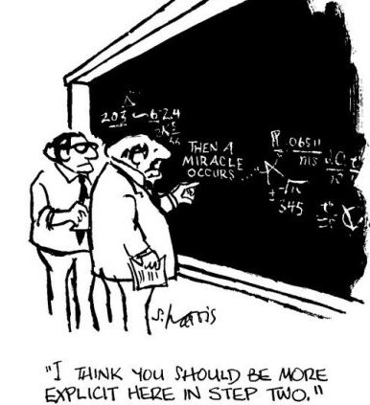
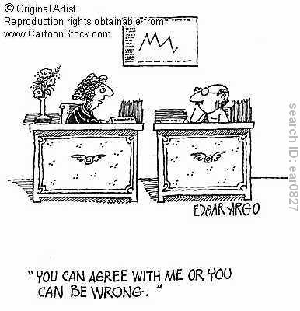
Terms of Engagement
Argument
Your personal viewpoint or stance on an issue
Justification
The reason or the rationale for your stance or viewpoint

Slide 4
What makes a Strong Justification?
Is this strong justification?
Why or Why not?
Write some flawed or weak justifications
What makes them weak?
Notes:
Skit
Mom can I have a cookie?
No
Why not?
Because I said so…

Slide 5
Characteristics of Flawed Justifications
Based purely on subjective opinion
Rely on an undefined “feeling”
Can’t be backed up with facts or science
Based on cultural bias which is not universal
Not relevant or logically linked to the facts of the case.
Notes:
Example at end on why for cookie, because sky is blue.

Slide 6
Silent Debate
Model format
Topic: Should all students at our school be required to wear uniforms?
One student represents pro, other con
There is NO TALKING!
Let’s watch...

Slide 7
Silent Debate
1A:
There should not be a school uniform because it does not allow students to express their individual personality.
2R:
Students are in school to learn, not to express their personality

Slide 8
Silent Debate, cont’d
1R:
Part of school is to figure out who you are and lack of ability to express personality does not help in that process.
2R:
Students learn to be like everyone else when it comes to fashion. There should be lessons that help students figure that stuff out, not clothing choices.

Slide 9
Next Argument

Slide 10
Silent Debate
2A:
There should be a school uniform because it makes the differences in how much money students have become invisible.
1R:
Students know those differences anyway-they compare shoes, accessories, cars, homes, electronics, etc. Uniforms just become an additional expense for families that can’t afford it already.

Slide 11
Silent Debate
2R:
It still decreases the biggest comparison factor- name brands and variety of clothing. Uniforms could be provided free of charge to families that cannot afford them.
1R:
Avoiding the problem won’t help students learn how to deal with real life problems like how to deal with people of different economic backgrounds.

Slide 12
Now it’s your turn… Should Dennis be allowed to reject life-saving medical treatments?
Rules of Silent Debate
Decide who is FOR (debater 1)
Decide who is AGAINST (debater 2)
Record on your handout
Begin each debate with an argument marked with your number and an “A”
1A – Dennis should…because…
Respond to arguments with your number and an “R”
2R – I disagree because Dennis…
1R- I understand your point, but…
Continue until argument is complete, then begin new argument
Draw a line on your paper between each new argument, please!
There is NO TALKING
Countdown clock

Slide 13
Discussion
Find strongest arguments with your partner
Did it rely on facts from the case?
Give voice to ethical principle?
Take the concerns of the stakeholders into consideration?
What makes a strong justification?

Slide 14
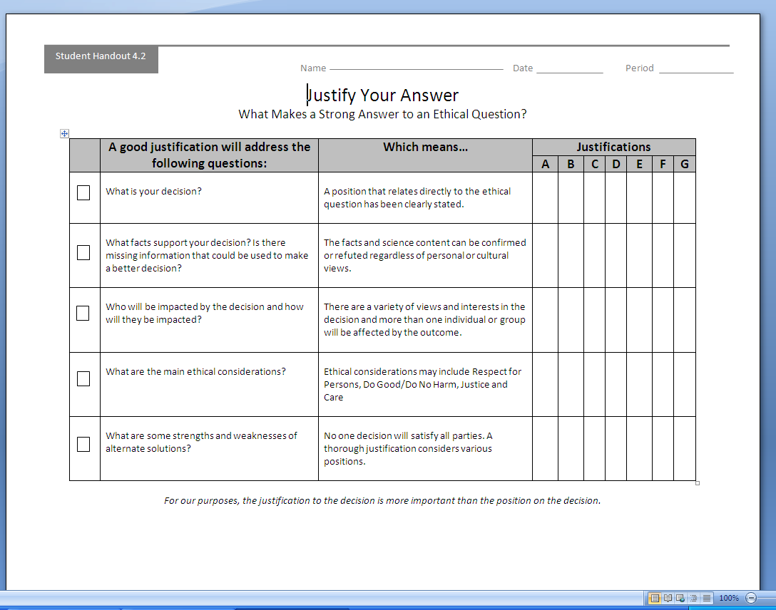
Elements of Strong Justification
May include:
Clearly-stated position that relates directly to the ethical question
Reference to important facts and science content of the case
Consideration of how other people will be impacted by the decision
Reference to one or more ethical considerations
Consideration of the strength and weakness of alternate solutions
Countdown clock

Slide 15
What if…
Dennis were not a religious person and simply wanted his illness to ‘run its natural course’, because that’s how life works?
Dennis was still under the legal care of his biological parents?
Dennis were younger, like 12? 10? 8 years old?

Slide 16
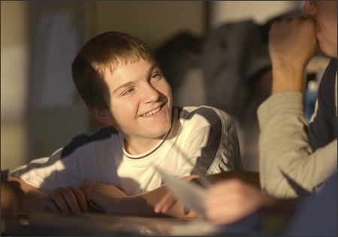
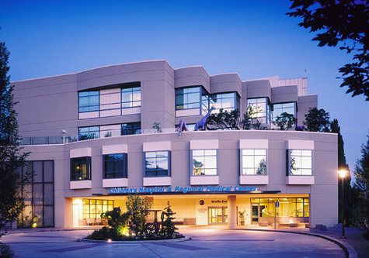
The Rest of the Story

