Slide 1

This curriculum is available on the NWABR website, http://www.nwabr.org
Permission granted for educational use
©2012 Northwest Association for Biomedical Research
^{All Rights Reserved}

Slide 2
Lesson 4
The Process of Scientific Research

Slide 3
Notes:
Credit: Maze Image. Nandhp/Wikimedia Commons.

Slide 4

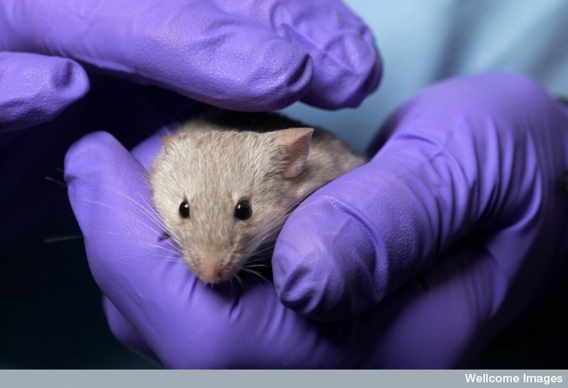
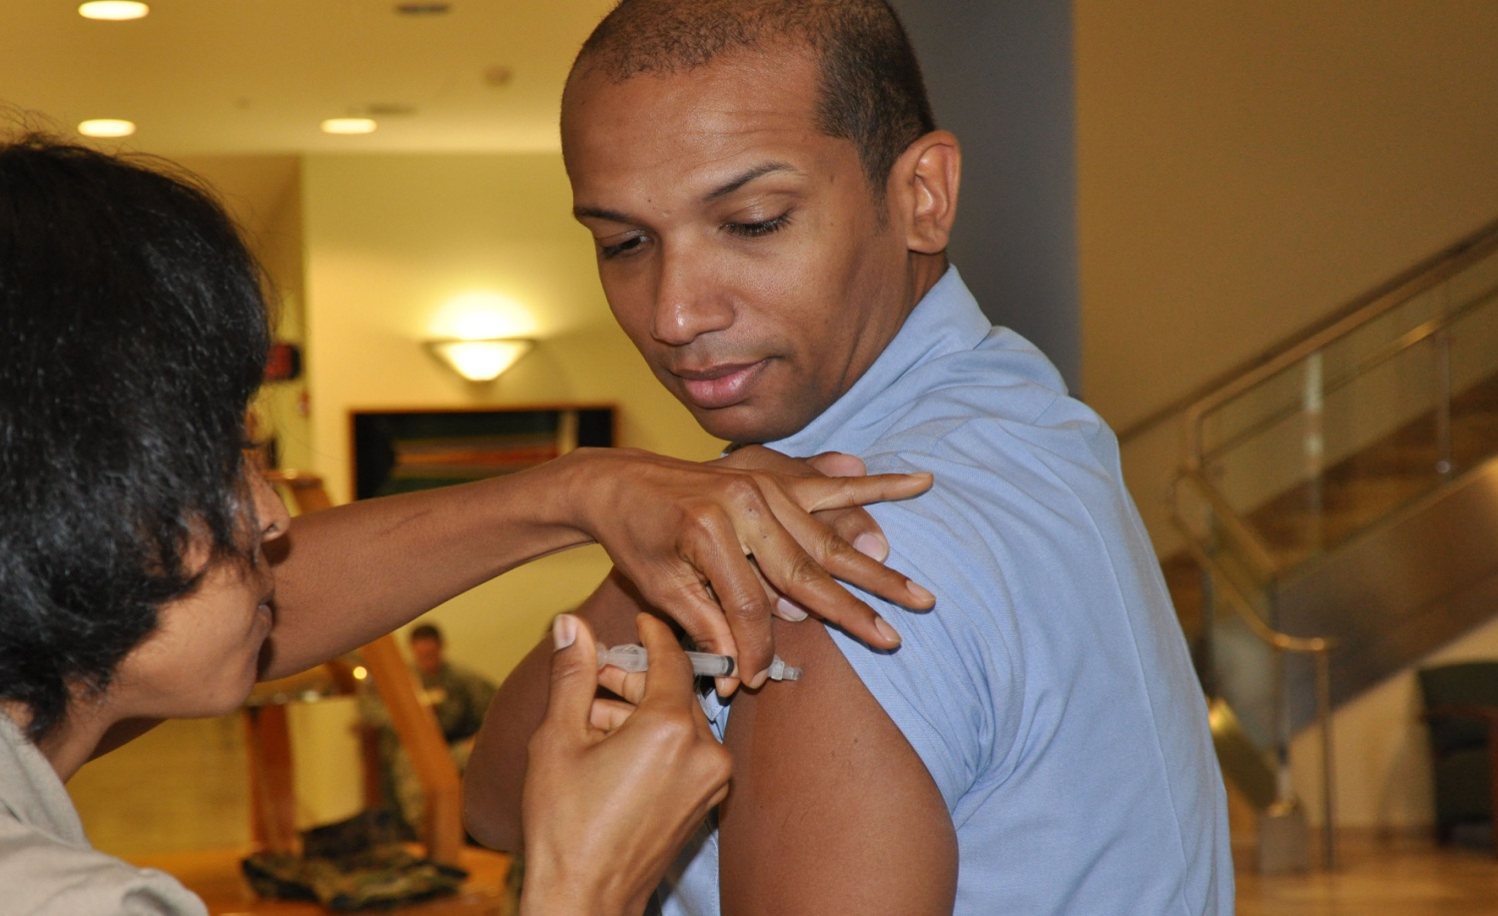
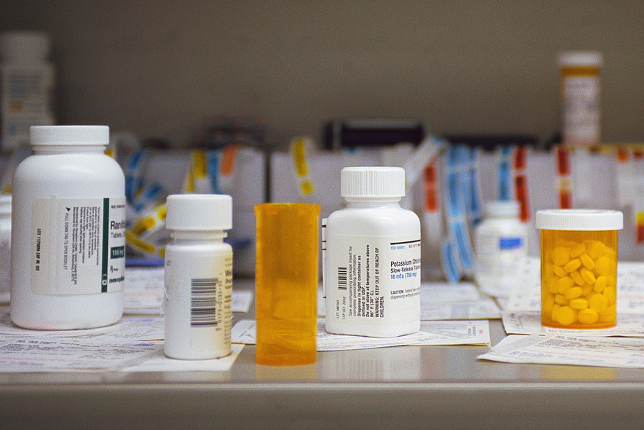

The Process of Translational Research
Therapies & Treatments
Basic Research
Animal Research
Humans in Research
How do we promote our medicine or treatment?
Does this increase our fundamental understanding of life processes and disease?
Does this help us understand molecular and cellular biology?
How can we test our idea for a medicine or new treatment in a whole, living system?
Is this medicine or treatment safe and effective for people?
Foundational elements:
Regulations Ethical Conduct Community Involvement

Slide 5
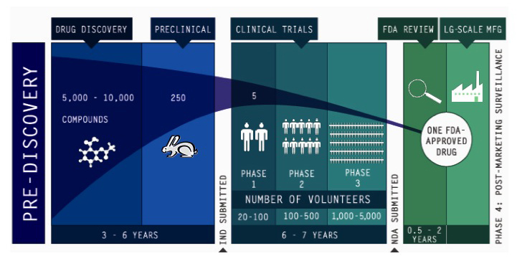
Drug Discovery & Development Overview
A Difficult Road
IND = Investigational New Drug NDA = New Drug Application
Credit: Pharmaceutical Research and Manufacturers of America. (n.d.). Inside innovation: The drug discovery process. Retrieved from http://www.innovation.org

